Slide 1
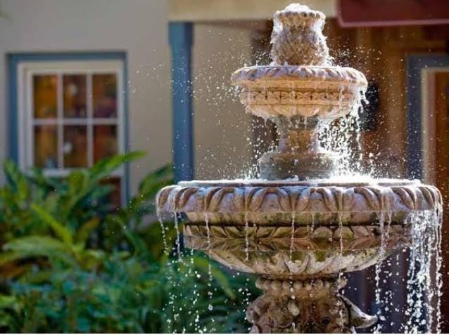
SMART
WATER
FOUNTAINS

Slide 2
PROBLEM STATEMENT
The biggest concern you really have with a water fountain is algae which will build up over time. Algae is not only unsightly, it can also cause build up inside your water pump and pipes causing issues. Here are some of the things that your fountain needs on a regular basis to keep it vibrant and appealing . Constant evaporation and splashes from the fountain will reduce the water level, and in a long run the water in the fountain reservoir will dry off, therefore we need a system that can constantly monitor the water level Therefore, monitoring the quality of source water would be very critical. Additionally, the data from water quality monitoring is very critical to determine the source of pollution. Therefore, an inexpensive biosensor/technology that is suitable for field testing is urgently needed for monitoring of source water in a real-time manner.

Slide 3
TECHNOLOGY STACK
DESIGNING
HARDWARE AND SENSORS
CLOUD PLATFORMS
IOT
SENSOR
DESIGN
REMOTE SENSING
CONTROL PANEL
COMMUNICATION MODULES

Slide 4
HARDWARES
Pumping Systems: The pumping systems with the jets or water diffusion plates to create the effect; plus the pump water inlet and the required valves and plumbing.
Electrical Systems: The electrical systems with sensors to maintain water level and shut down electrical equipment when water levels are inadequate.
Water Sensor: The data acquired from the sensors will be transmitted to the control unit. Control unit will then have some logic designed to send corresponding signals to control other blocks of the water fountain.
Power Supply: A certain amount is electricity is surely needed to run this water fountain. The rating of these submersible pumps varies from 10 to 50W, depending on the size of the fountain.

Slide 5
Microcontroller: A float switch constantly monitors the water level in the fountain. When the water goes below a desired level, the float switch sends signal to the microcontroller that turns on the refill pump and when the water is at optimal level the refill pump automatically turns off.
LED or Buzzer : When water level increases and touches the sensor, the Red LED will glow indicating that there is water within the tank. As the water level continues to rise and reaches half the tank, Yellow LED will glow. When the water in the tank rises to full an alarm is made by the buzzer as an indication that the tank is full.
Wifi Module: Connect the red wire to VIN(3.3V) to the +3.3V power from the microcontroller. Connect the green wire to the TX of the wifi module and microcontroller. Connect the yellow wire to the RX of the wifi module a connect the black wire to the ground.

Slide 6
PROBLEM SOLUTION
Water fountains use submersible pumps designed for safe operation in water. The flow rate switch is usually a button that slides from side to side or a recessed dial located on one side of the pump's housing. Locate the flow control switch if the pump has one. To reduce the water flow rate of domestic or industrial applications, devices called flow restrictors are used. They are placed into the line of flow and essentially reduce the space that the water can flow through. Depending on where you live and where your fountain is placed, you'll want to regularly clean your fountain to prevent algae from forming and to keep your outdoor fountain water clean. We recommend cleaning your fountain every 1-3 months to maximize the longevity and performance of your outdoor fountain and pump.

Slide 7
THANK YOU

